Slide 1
Novozyme Enzyme Stability Prediction
Akash Matta
Phanith DSV
Himaja Narina
Shravani Naikoti

Slide 2
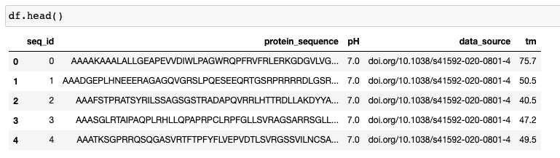
Novozyme Enzymes Dataset
Dataset has 4 variables:
Melting temperature (Target variable)
Protein_sequence
pH levels
Data Source

Slide 3
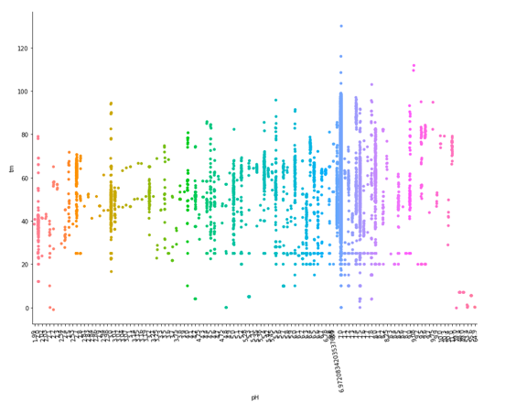
Novozyme Enzymes Dataset
The dataset has more than 30,000 examples and the target, tM is distributed, showing that it is a good representation of the problem for us to train a model.
The distribution of temperature with respect to pH values is evenly distributed with slight skew to the left.

Slide 4
Linear Methods
It was observed that training data (protein sequences) contains mutations while the test data contains "only" mutations.
Using Leavenshtein Distance, distance is calculated between each set of pairs and assigned group numbers to each sequence based on a small threshold length in terms of insertions or deletions.
Average Spearmann Correlation Score for GroupKFold was 0.227(Training Set)

Slide 5
Linear Methods
Upon using Ridge Regression and 'TdidfVectorizer' on the resulting feature set, The results were better than Linear Regression with the mean correlation score improving to 0.35.
In terms of feasibility of learning, while the training score improved using ridge regression, it was well below scores generated by other methods and pointed towards more complex relationship between unknown features.

Slide 6
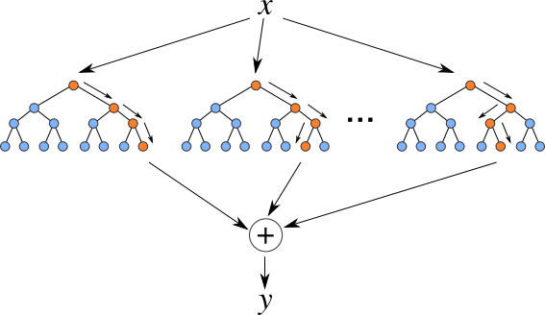
Random Forest Regression

Slide 7
Random Forest Regression
This ensemble methods using decision tree regressors was fit on data with slightly different features.
Missing values were imputed
Organizations were encoded to see if the samples were affected based on the lab where they were measured.
As expected, there was lot of overfitting with respect to training data, since the accuracy was unusually high.
The number of estimators used were over 500 and the in sample error were very low; it’s a case of overfitting.

Slide 8
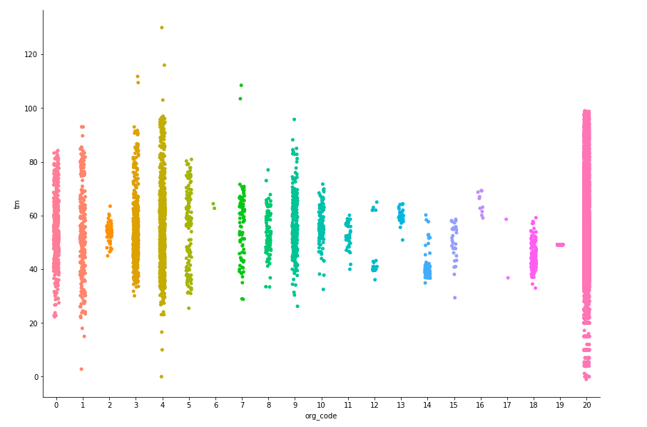
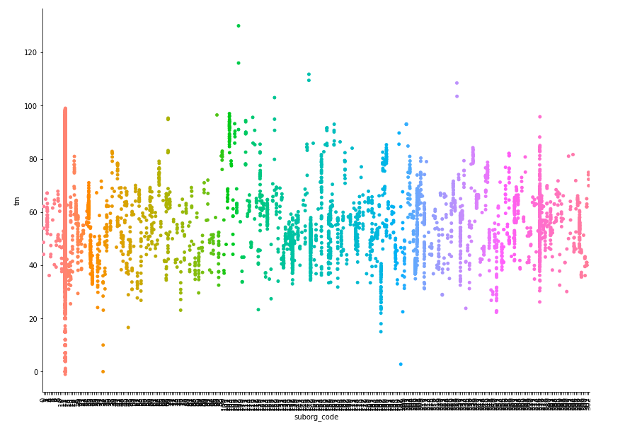

Slide 9
Using SimpleImputer, all amino acids in protein_sequence are listed and visualized.
Hyper Parameter Tuning and All the columns are normalized and brought down to same distribution.
This Submission gave a score of 0.385 on Kaggle when Random Forest Method was used.

Slide 10
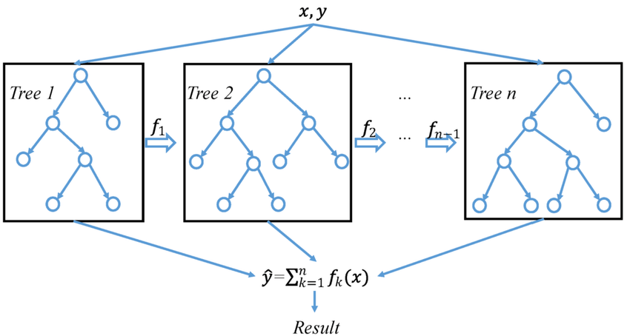
XG Booster

Slide 11
XG Booster
This class of ensemble learning method, also known as gradient boosting can be is known for performing at the top in terms of competitions. Execution speed and model performance are the two primary benefits of using XGBoost.
To perform EDA, a Python tool ‘protolearn’ was used to extract features from protein sequences .
The pre-processing module enables user to prepare the datasets in accordance with certain requirements, such as removing sequences that include unnatural amino acids or changing alphabetical strings into integers, amongst other things.

Slide 12
XG Booster
Custom functions were written to find features like amino acid composition, AAIndex1-based physicochemical properties, Atomic and bond composition etc.
Given the default number of estimators, results from this method had a MSE of 73.438; variation in terms of temperature is larger on the training set. The method performs better than Random Forests but it can be improved with further parameter search.

Slide 13
Advanced EDA language Model ProBert
BERT is an open source machine learning framework for Natural Language Processing (NLP) to help computers understand the meaning of ambiguous language in text by using surrounding text to establish context.
ProtBert could be used for protein feature extraction or to be fine-tuned on downstream tasks.
It has been noticed in some tasks you could gain more accuracy by fine-tuning the model rather than using it as a feature extractor.

Slide 14
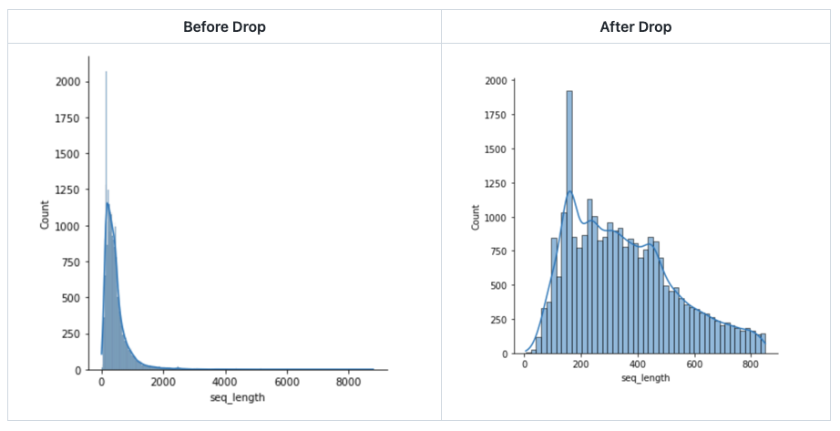
Dropping sequences that are too long to save the GPU memory.

Slide 15
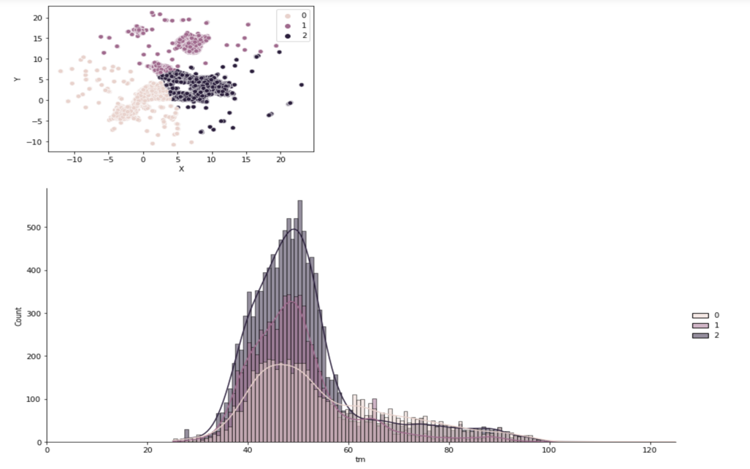
Dimensionality reduction methods like UMAP are used to reduce the dataset to two dimensions to observe patterns.

Slide 16
Protein Bert Embed Swapped Tokens
In Embed Swapped Token method is to handle Amino acids by placing two tokens after a special token within a single sequence. That is in this method, the token at the replacement position is expressed with the \<OTHER> special token. Then, after the special token, place the amino acids before and after the replacement to form the final sequence.
Then we Fine Tune the newly formed enzyme by using the pre- trained models of protBERT and train the model. Once training is done we run our model to test it on the test.csv.

Slide 17
Thank you

